Slide 1
Cinderford Town Council Briefing
Matt Smith Full Fibre Ltd.
11/1/22

Slide 2
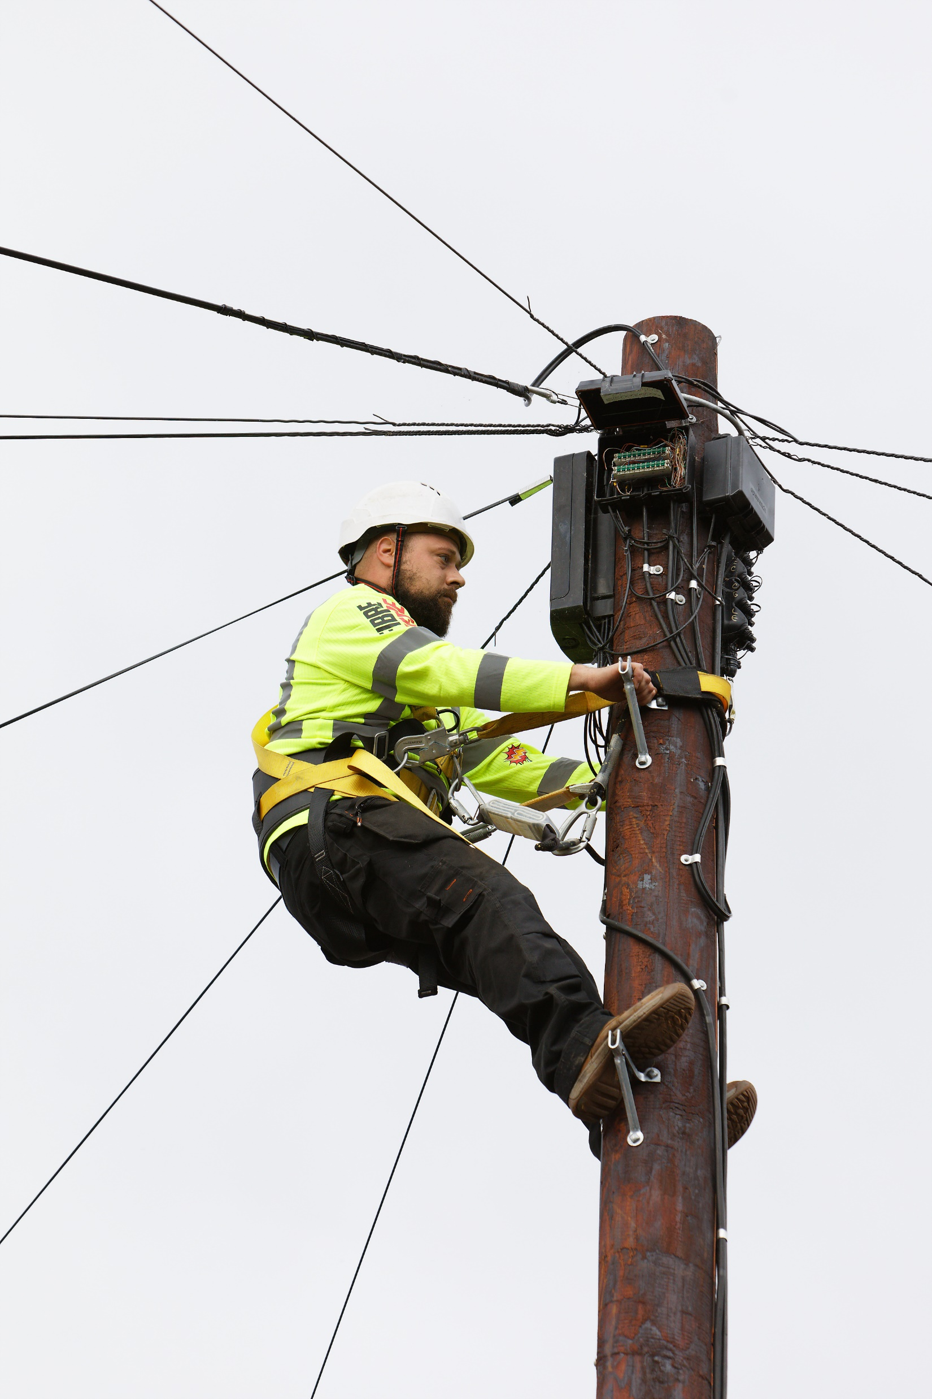
Who are Full Fibre Ltd?
Established in 2017 & based in Exeter with 3 Regional Offices
Full Fibre broadband infrastructure - The clue’s in the name!
FTTP access to every single property in the towns we serve
In Cinderford because of Fastershire Funding & Community Campaign
Gigabit Capable >1,000Mbps
Symmetrical Offerings – Same Upload as Download
Wholesale only – Promoting a choice of ISPs and real competition
Independent of Openreach but we use Openreach’s Ducts & Poles (PIA) as well as our own infrastructure
Targeting >500,000 premises by 2025 - focused on small to medium sized towns
Actively building in 12 towns
Announced 48 towns to date across 10 counties
236 towns under consideration across 26 counties
Funded by Basalt Infrastructure Partners III

Slide 3
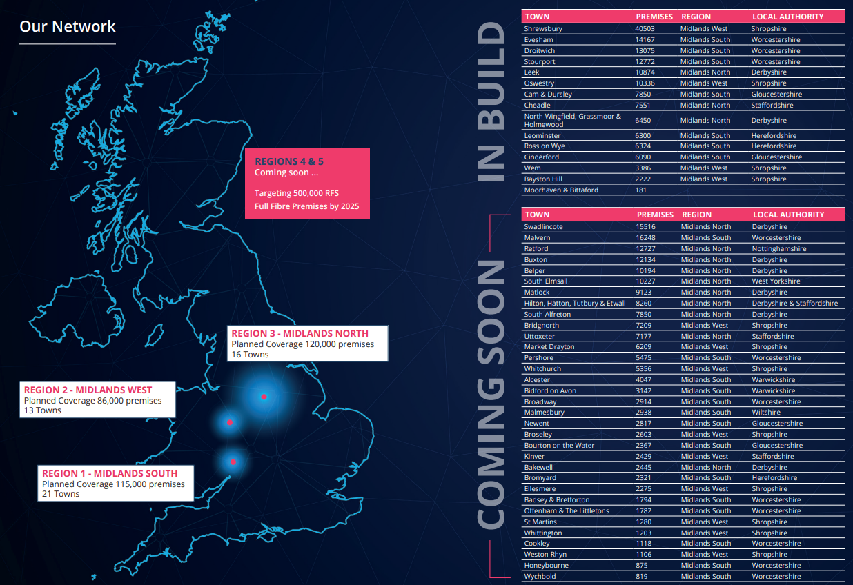
Where are we building?

Slide 4
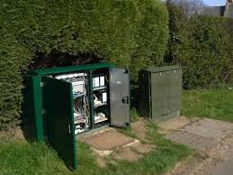
Background to the Broadband Infrastructure Industry
Dominated by Openreach and Virgin Media (in cities)
Traditionally copper based moved to Hybrid Copper / Fibre (FTTC) 2011-18
FTTC driven by BT Openreach trying to extend commercial lifespan of Copper
Never going to be the long term solution for UK connectivity
Recent rise of ‘alt-net’ competitors mostly building Full Fibre to the Premise
Openreach response has been to pivot to Full Fibre & discontinue copper by 2025/26
Government now targeting 85% Full Fibre by 2025 to strengthen the economy and play catch up with other nations’ connectivity levels

Slide 5
But we have fibre already!
FTTC has been mis-sold as Fibre for many years
In reality its a hybrid solution with some fibre in it but reliant on copper to the home
Maximum FTTC speeds up to 80Mbps Download & 20Mbps Upload
BUT
Speed is highly sensitive to the amount of copper in your connection
Most connections experience variability in performance and drop outs
The Download / Upload imbalance can be an issue for some activities
This mis-selling has created confusion with consumers which is difficult to overcome
Headline speeds are OK for many for now but the world is not standing still
The copper network will become less & less fit for purpose before it is decommissioned in the mid-late 20’s

Slide 6
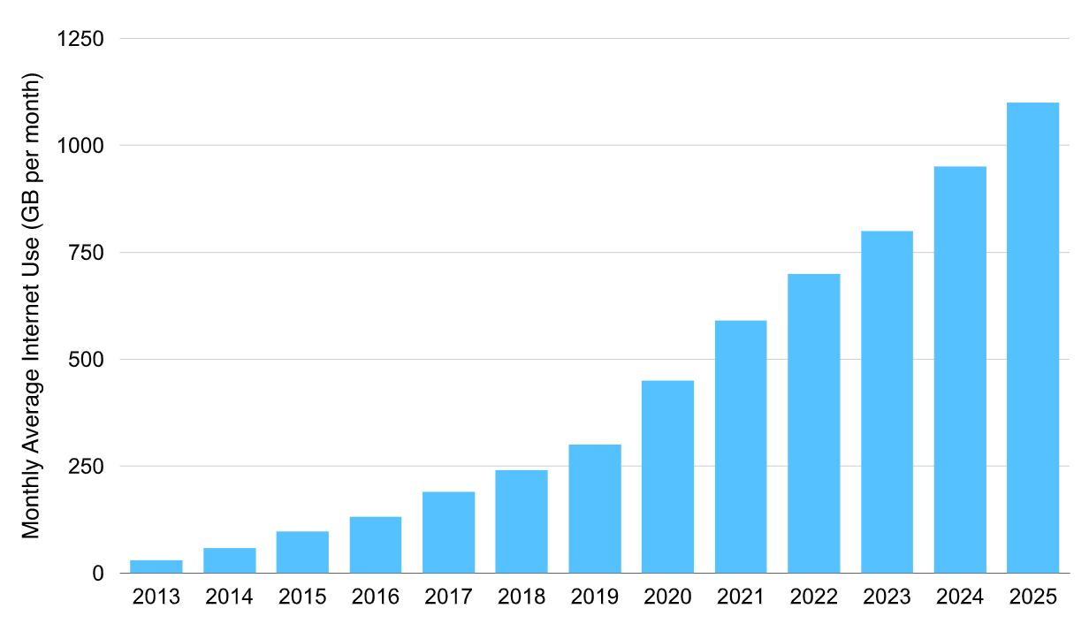
Why we need real Fibre
Copper has come to the end of its useful life
The Pandemic increased pressure on the network and gave a taste of where consumption would have been anyway in the near future
During 2020 the copper network experienced 5,000 outages
Performance was 30% poorer than the previous year
But isn't 5G the future?
5G provides very high speeds & 50% UK population may have access by 2023 (mainly in urban areas)
However
The spectrum is limited
The shared nature of the medium can make contention and security a problem
It is not an alternative to or substitute for full fibre but it will compliment it in the future
5G will also require fibre everywhere to link small cell sites – it is not a case of either or

Slide 7
Why we really need Full Fibre
Demand for higher speeds is relentless
Video the biggest driver
More people consuming high resolution & on-demand content or video calls
Emerging applications, 8k TV, Online Gaming, the Tactile Internet (telehealth) & Immersive Media (Virtual & Augmented Reality)
These require far greater bandwidth to support real time human – computer interactions within the parameters of human reaction times
More connected devices (IOT) in every home & increasing time spent on line are intensifying the demands on the same connection
40% of homes will need 1Gbps/600Mbps & 42% more will need 300/300Mbps by 2025 (WIK consulting)
Even occasional users will need to go faster with improvements to basic software
Even if you cant imagine using bleeding edge technology, others will be.
In doing so they will add pressure to the copper network.
So what is a decent connection today will not remain so

Slide 8
Why we really need Full Fibre
Full Fibre is Future Proofed
Fibre can carry multiple terabytes of data per second
Not just headline speed - Symmetry / constancy / latency / contention / reliability and the upgrade path are all critical
Latency levels required for the tactile internet and immersive media can only be provided by full fibre
Symmetrical connections are therefore increasingly important - Video Calling, Gaming and Cloud Computing require 2 way traffic as do people working from home but accessing their work placed network through a VPN and can only be provided by full fibre
There is virtually no contention with full fibre so busy hour issues will be a thing of the past
Full Fibre is 5x more reliable than Hybrid Copper broadband

Slide 9
Network Elements
BT Openreach Exchange
Full Fibre CBT
Full Fibre Cabinet
BT Openreach Pole
Full Fibre Joint / FDP
Full Fibre Joint / FDP
Relatively Non-Invasive build
Limited dig under TM to clear Openreach Duct blockages
Some Openreach Poles will need to be replaced
Full Fibre Poles required in areas of directly buried copper c. 10% of most areas
Installation of cabinets & poles (Incl in Conservation Areas & AONBs) excluded from formal planning controls by the Electronic Communications Code
We do work with residents to find the least contentious locations
Requires Full Fibre Pole
Directly Buried Copper
Blocked Ducts

Slide 10
Progress to date
You can’t build a fibre network overnight. We have started early to satisfy the mid-term demand
Our presence may accelerate Openreach or other alt-nets to respond
This is our risk but if it happens, it can only be good for consumer choice
Preparation
Build
Commissioning
Selection
Funding Allocation
HLD
Surveying
LLD
Wayleave Negotiation
Local Authority Noticing
Assign Contractor
SLD
Review DB area solutions
New Pole Designs
New Pole Consultation
Blockage Clearance
Cabinet Installation
Spine Build – Sub Ducting and FDPs
CBT Installation on existing Poles
Pole Replacements & New Pole installation
CBT installation on New Poles
MDU Installations
Cabinet Switch On
Audit & Testing
RFS
Installations

Slide 11
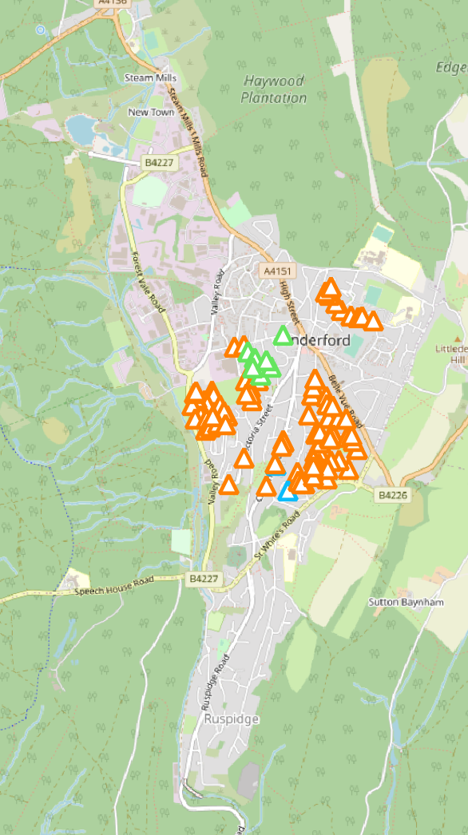
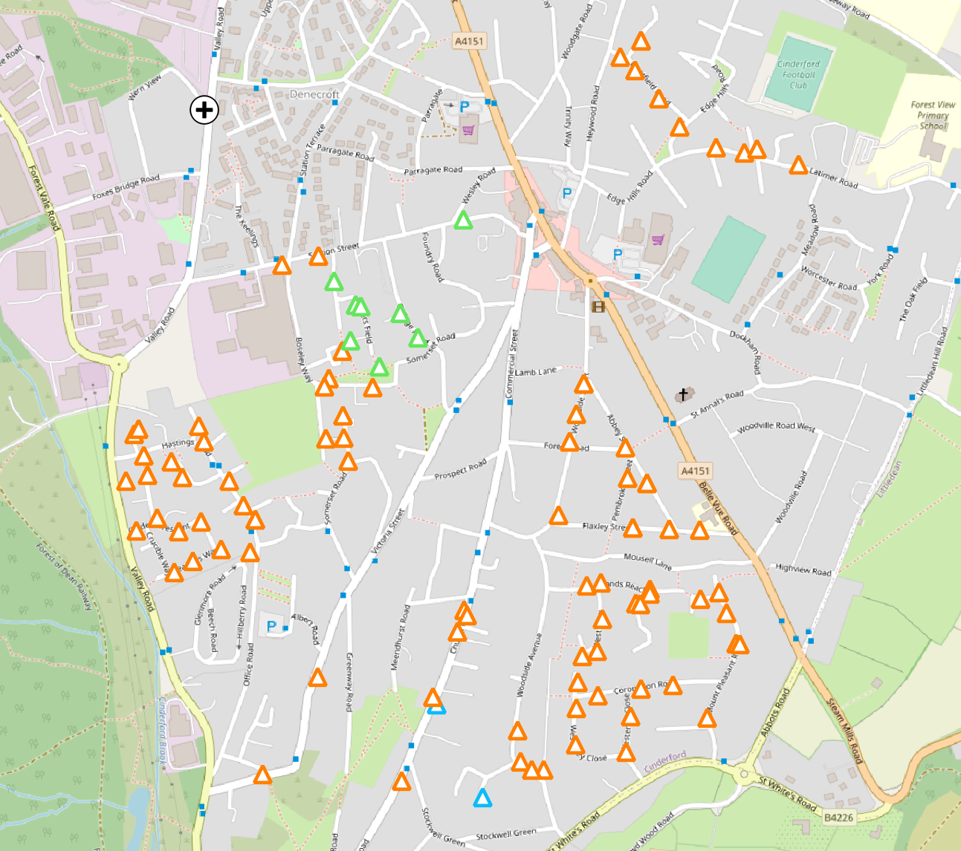
FDP/CBTs in Deployment

Slide 12
How to order a service
www.fibreheroes.co.uk
Check if you are ready for service
Pre-register & we’ll contact you if not
Select your preferred ISP
When you order we guarantee a installation within 10 days

Slide 13
Thanks for listening
Any further questions?
Pynes Hill Court, Pynes Hill, Exeter, England, EX2 5AZ
enquiries@fullfibre.co
0333 121 0505

